Slide 1

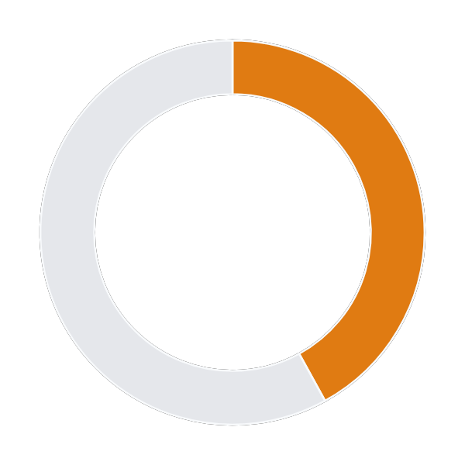
Career Pulse
BUILD FOR BHARAT 2.0 · 2026
Data Scientist · Bengaluru
Vriddhi
42%
India’s workforce intelligence engine — it tells every learner what to learn next, and what that skill will be worth.
role match
LEARN NEXT
Problem Statement – Intelligent Talent & Workforce Ecosystem
Machine Learning
+18% match · +₹2.1L / yr
Anchored Problem Area – Career Intelligence
PREDICTED SALARY
₹22.4 LPA
Stakeholders Served – Students · Recruiters & HR · Universities
band ₹19.8L – ₹25.1L
Team Name – unpaid interns
RISING IN YOUR CITY
LangChain ↑340%
MLOps ↑89%
Project – Vriddhi — AI-Powered Career Intelligence Platform
Live architecture demo– yrxkush.github.io/Vriddhi
Prototype screen · sample data
Notes:
Open with the one question Vriddhi answers: what should I learn next, and what will it be worth? Then read the problem statement line.

Slide 2
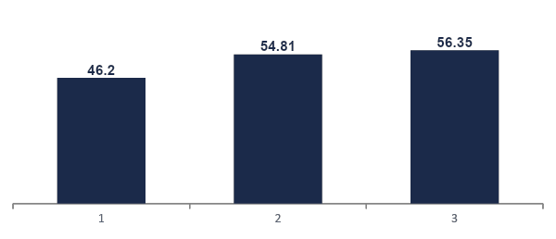



THE PROBLEM
BUILD FOR BHARAT 2.0
“1.5 million engineers graduate every year. Nobody tells them which skills the market will actually pay for.”
THE GROUND REALITY
EMPLOYABILITY IS CLIMBING — TOO SLOWLY
1.5M
Engineers graduate every year
Only ~10% were expected to land jobs in FY25.
Source: TeamLease via Business Standard, Sep 2024
44%
Of graduates are still not job-ready
National employability is 56.35% — the other 44% lack the skills employers want.
+10 pts in four years. ~44% of each batch still exits college without job-ready skills.
Source: India Skills Report 2026
THE BROKEN SIGNAL TRIANGLE
63/100
Student
Recruiter
University
Indian workers need retraining by 2030
~70 million may never get it — they don’t know what to learn.
“What should I learn next?”
“Which skills are rising?”
“Is our syllabus current?”
Today: YouTube advice & seniors’ anecdotes
Today: lagging annual reports
Today: multi-year revision cycles
Source: WEF Future of Jobs 2025
Vriddhi · Workforce Intelligence for Bharat
2
Notes:
Three stakeholders ask three versions of the same question, and none of them share a data signal. That is the gap Vriddhi fills.

Slide 3
WHY EXISTING TOOLS FAIL
BUILD FOR BHARAT 2.0
“Job portals show listings. Chatbots guess. Nobody prices a skill.”
PROPOSED SOLUTION — WHY NOT JUST USE NAUKRI, LINKEDIN OR CHATGPT?
Capability | Job Portals (Naukri / LinkedIn) | Generic AI Chatbots | Govt Skill Portals | Vriddhi
Salary impact of a single skill (₹) | ~ Salary range per posting only | ✗ Unsourced guesses | ✗ Not available | ✓ ML-predicted + SHAP-explained
Rising vs dying skill forecast | ✗ Today’s snapshot only | ✗ Frozen at training cut-off | ✗ Annual reports | ✓ 6-month ARIMA forecast by role & city
Personal gap analysis + ranked ROI | ~ Keyword match to jobs | ~ Generic, not your resume | ✗ Not available | ✓ Match % + ranked gaps with ₹ impact
Curriculum audit for colleges | ✗ Not available | ✗ Not available | ~ Framework docs, no scoring | ✓ Course-by-course alignment + PDF
Answers grounded in Indian data | ~ Listings only, no reasoning | ✗ Hallucination-prone | ~ Static content | ✓ Agentic RAG over our own pipeline
KEY INNOVATION
THE ONE QUESTION
We put a rupee value on every skill. Every recommendation carries three numbers — match gain for your target role, salary impact in ₹, and the skill’s demand trend in your city — computed from one shared Indian skill graph, not from an LLM’s memory.
“What should I learn next — and what will it be worth?”
Vriddhi · Workforce Intelligencefor Bharat
3

Slide 4
TECHNICAL APPROACH
BUILD FOR BHARAT 2.0
“One extract_skills() engine, applied to four data sources, powers every module.”
1
Data Ingestion & ETL
2
NLP & Skill Ontology
3
Intelligence & ML
4
Agentic AI & Delivery
Naukri postings: 15,000+ listings — role, skills, city, pay
LinkedIn & Glassdoor: salary benchmarks
NSDC & NASSCOM: national skill frameworks
IIT / NIT syllabi + resumes → raw MongoDB with source provenance
Vriddhi-NER: our fine-tuned skill extractor + ESCO dictionary
Normalization: “ML”, “M.L.” → Machine Learning (ESCO)
MiniLM-L6-v2: text → 384-d vectors
ChromaDB: 1,200+ embedded knowledge chunks for RAG
SkillRadar: ARIMA demand forecast
TalentMatch: cosine-similarity gap engine
CompIntel: RF + XGBoost + GBM salary ensemble
CurriculumSync: syllabus-vs-market scorer
Knowledge graph + MLflow tracking
Vriddhi-Counselor: agentic reasoning engine tool calls route each query to the right module
RAG over ChromaDB: grounded, cited answers
Streamlit multi-page dashboard
FastAPI: 10+ endpoints, OpenAPI docs
→
→
→
pandas
MongoDB
Custom NER
ESCO
ChromaDB
sklearn
XGBoost
SHAP
Vriddhi-Counselor
FastAPI
Streamlit
DATA CONTRACT BETWEEN LAYERS
raw_postings · raw_salaries
raw_syllabi · raw_resumes
processed_postings
+ Vriddhi_knowledge vectors
trends · match scores
salary predictions · reports
/api/v1/* · /chat
Streamlit · PDF
Vriddhi · Workforce Intelligence for Bharat
4

Slide 5
OUR ML PIPELINE — BUILT FROM SCRATCH
BUILD FOR BHARAT 2.0
“Every ML model is trained on Indian data by our team. Open-source stack, zero licensing cost.”
SKILL EXTRACTION — WORKED EXAMPLE
TRAINING PIPELINE — ON OUR LAPTOPS
RAW JOB POSTING
PASS 1 · ESCO DICTIONARY
NORMALIZED RECORD
1
Collect
“Looking for a senior engineer with experience in Python, TensorFlow, ML pipelines, A/B testing, SQL and Apache Spark. Strong statistical analysis a must.”
Python
TensorFlow
{
"role":"Data Scientist",
"skills": 7,
"esco": true,
"city": "Bengaluru",
"exp": [4, 7],
"pay_lpa": [18, 28]
}
15,000+ Indian job postings, resumes & syllabi
SQL
Apache Spark
2
Auto-label
→
→
ESCO dictionary tags skills; 500 postings hand-verified
PASS 2 · Vriddhi-NER (ours)
3
Fine-tune
ML Pipelines
A/B Testing
PyTorch + LoRA on a laptop GPU; every run logged in MLflow
Statistical Analysis
4
Ship offline
Naukri · Bengaluru · ₹18–28 LPA
Export to ONNX / 4-bit GGUF — no internet needed
MODEL CARD — EVERY PREDICTION IS OURS
Model | Base / technique | Trained on | Runs on | Evaluation
Vriddhi-NER | ESCO dictionary + regex + LLM-assisted | 15k+ postings, 500 verified | CPU · spaCy | Precision on held-out postings
CompIntel | RF + XGBoost + GBM ensemble | Indian salary records | CPU · scikit-learn | RMSE · MAE · R² (5-fold CV)
SkillRadar | ARIMA + linear regression | Monthly skill counts per role × city | CPU · statsmodels | MAPE on 3-month hold-out
Skill Embeddings | MiniLM-L6-v2 (pre-trained) | Skill pairs co-occurring in postings | CPU · 384-d vectors | Precision@5 in TalentMatch
Vriddhi-Counselor | Agentic function calling + ChromaDB | Module outputs + market context | Reasoning layer | % answers grounded in module data
Vriddhi · Workforce Intelligence for Bharat
5

Slide 6
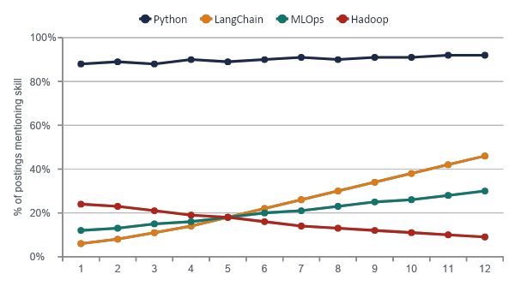
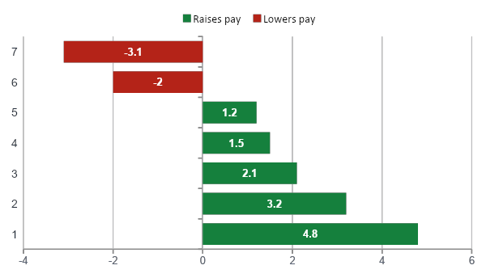
SKILLRADAR & COMPINTEL
BUILD FOR BHARAT 2.0
“Know which skills are rising — and exactly how much each one moves your pay.”
SKILLRADAR — DEMAND TREND (DATA SCIENTIST · BENGALURU)
COMPINTEL — WHY THIS SALARY? (SHAP DRIVERS, ₹ LAKH)
RISING
STABLE
DECLINING
PREDICTED SALARY
WHAT-IF SIMULATOR
LangChain +340%
MLOps +89%
Kubernetes +45%
Python ~95%
SQL ~82%
(core baseline)
Hadoop −52%
jQuery −67%
(deprioritize)
₹22.4 LPA
+ Kubernetes
85% band: ₹19.8L – ₹25.1L
₹25.1 LPA
RF + XGBoost + GBM ensemble
+₹2.7L from one skill
Charts show prototype sample outputs. "F" = 6-month forecast horizon.
Vriddhi · Workforce Intelligence for Bharat
6

Slide 7
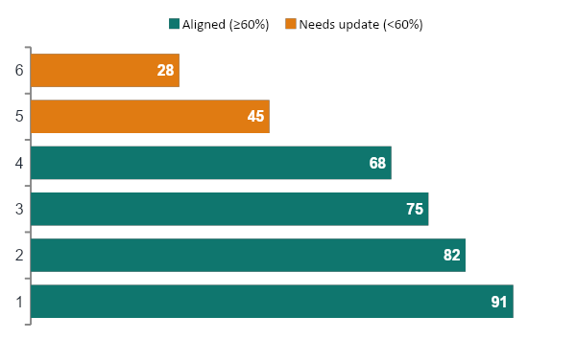
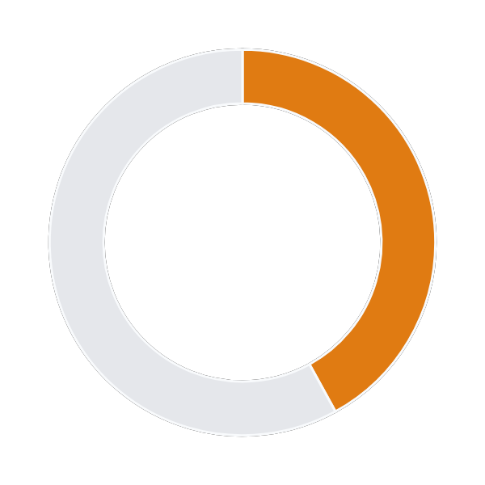

TALENTMATCH & CURRICULUMSYNC
BUILD FOR BHARAT 2.0
“The same engine that tells a student what’s missing tells a college what to teach.”
HOW THE GAP ENGINE RANKS
CURRICULUMSYNC — SYLLABUS VS MARKET DEMAND
TalentMatch
1
Extract
✓ aarav_resume.pdf parsed — 4 skills
resume skills with the same NLP engine
Target: Data Scientist · Bengaluru
42%
2
Build
the role’s ideal skill vector from all matching postings
role match
LEARN NEXT
3
Score
1 Machine Learning
+18% · +₹2.1L
cosine similarity → match %
2 TensorFlow
+14% · +₹1.8L
Auto-generated Dean / HOD report
3 Statistics
+12% · +₹1.2L
4
Rank
each missing skill by Δ match × ₹ impact from CompIntel
Keep: courses already aligned with hiring demand
Add: missing market skills — MLOps, cloud, LLM apps
Electives: suggested and mapped to ESCO skills
Build my 12-week plan →
Sample outputs from the prototype on a representative CS curriculum.
Vriddhi · Workforce Intelligence for Bharat
7

Slide 8
AGENTIC CAREER COUNSELOR
BUILD FOR BHARAT 2.0
“Every number comes from our trained models — not generated, computed.”
AGENTIC PIPELINE — NOT A CHATBOT
1
User asks in plain language
Vriddhi Counselor
I know Python and SQL. How well do I match a Data Scientist role?
● live · pipeline-grounded
I know Python and SQL. How well do I match Data Scientist, and what should I learn next?
2
Our reasoning engine parses intent
Vriddhi-Counselor autonomously picks the right intelligence
modules — no hard-coded routing, no keyword matching.
You match 42% of the Data Scientist profile in Bengaluru.
Learn next:
1. Machine Learning +18% · +₹2.1L
2. Data Visualization +14% · +₹1.2L
3. Applied Statistics +12% · +₹1.2L
Est. total impact: +₹4.5L / yr
3
Function calling
Calls TalentMatch + CompIntel (and SkillRadar if trends are asked).
4
ChromaDB retrieval
TalentMatch
CompIntel
ChromaDB
Pulls market context, e.g. “ML demand grew 23% in Indian postings.”
What if I add Kubernetes?
5
Grounded answer
Every number traces back to a module output or a retrieved chunk, tagged with its source.
Counselor is typing…
Ask about any role, skill or city…
Guardrail: the agent may only state numbers that a module returned — no free-floating LLM guesses.
Vriddhi · Workforce Intelligence for Bharat
8

Slide 9
FEASIBILITY & VIABILITY
BUILD FOR BHARAT 2.0
“Open-source end to end. Every ML model trained on Indian data by our team.”
₹0
Licensing cost — 100% open-source stack
2
Custom ML pipelines trained in-house (Ensemble + NER)
~15K+
Indian job postings processed through our pipeline
10+
REST endpoints with OpenAPI docs
TECH STACK BY LAYER
RISKS & HOW WE HANDLE THEM
Layer | Tools
Data | MongoDB · pandas · ChromaDB
NLP | ESCO taxonomy · spaCy · sentence-transformers (MiniLM-L6-v2)
Reasoning | Agentic function calling · ChromaDB retrieval · grounded synthesis
Embeddings | sentence-transformers (MiniLM-L6-v2) · cosine similarity
ML + MLOps | scikit-learn · XGBoost · statsmodels · SHAP · MLflow
Backend | FastAPI (Python) · OpenAPI / Swagger
Frontend | Streamlit · plotly · pyvis
Reports | fpdf2 — automated PDF generation
Data freshness & scraping limits
Small-model hallucination
Public datasets + official APIs on a scheduled batch refresh — no fragile live scraping.
The counselor may only state numbers a module returned; architecture enforces grounded answers only.
Metro-skewed salary data
Resume privacy
City-tier features, confidence bands shown to users, SHAP exposes bias.
Resume data is processed in-session only not stored, not shared. Designed around DPDP Act, 2023.
Vriddhi · Workforce Intelligence for Bharat
9

Slide 10
IMPACT & ROADMAP
BUILD FOR BHARAT 2.0
“A student shouldn’t need a senior’s contact to know what the market pays for.”
4.33 Cr
students in Indian higher education
46,600+
universities & colleges (1,168 + 45,473)
1.5M
engineering graduates every year
AISHE 2021-22
AISHE 2021-22
TeamLease, 2024
BEFORE VS AFTER
ROADMAP
Stakeholder | Today | With Vriddhi
Students | Anecdotal advice, guesswork on what to learn | Ranked skills with ₹ impact, in minutes
Recruiters | Long time-to-hire, offers priced by gut | City-level demand + salary benchmarks
Universities | Multi-year syllabus cycles, no market data | Course-level alignment score + PDF report
NOW · HACKATHON MVP
4 modules + 2 in-house models, offline counselor, Streamlit + FastAPI
3 MONTHS
Live job-portal feeds · Hindi & regional-language counselor fine-tune
6 MONTHS
ALIGNED WITH NATIONAL MISSIONS
Student mobile app with on-device model · B2B API for HR platforms
NEP 2020
Skill India
Viksit Bharat
Industry-relevant curricula — CurriculumSync gives HODs the evidence.
Demand-led skilling — SkillRadar shows where demand is, by city.
A productive workforce needs a live skills map, not yearly reports.
12 MONTHS
NSDC / Skill India partnerships · college licences for CurriculumSync
Vriddhi · Workforce Intelligence for Bharat
10

